Slide 1
DGEobj: An R object to capture DGE Workflows
John Thompson
Translational Bioinformatics
14Jan2019

Slide 2
DGEobj Overview
The DGEobj package defines a data structure that extends the concept of the ExpressionSet and Summarized Experiment to support capture of downstream workflow results
Key Features:
Painlessly enforces a standard data structure
Captures intermediate outputs
Captures project metadata (as attributes)
Captures parent-child relationship of contained data objects
Square bracket subsettable; easy filtering of genes/samples
Accessor functions to build and access data in DGEobj format
Convert to/from ES and SE data structures
Input data from Xpress, Omicsoft, text files
Plug and play into GECO (shiny app) resource
Facilitates data sharing and automated cross project analysis

Slide 3
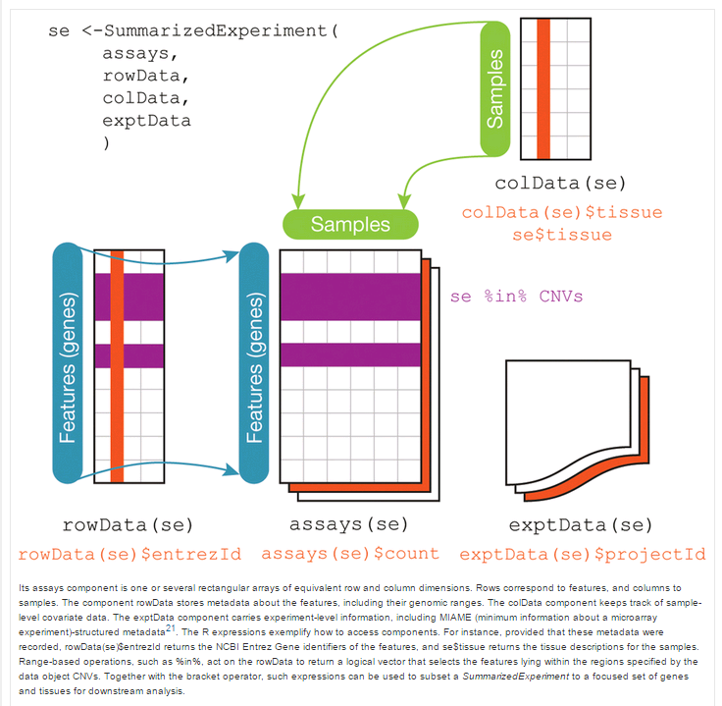
Summarized Experiment structure
SE and ES
limited to 1 each rowData and colData elements
No parent-child relationship
DGEobj removes those limitations and introduces parent-child relationships

Slide 4
DGE.Tools2 Package
Wrapper around DGEobj
Implements Limma/Voom DGE workflow
voom with quality weights
Duplicate Correlation
Surrogate Variable Analysis
Easily extensible
Provides assorted plotting tools for common plots (ggplot)
Codifies best practices for DGE analysis

Slide 5
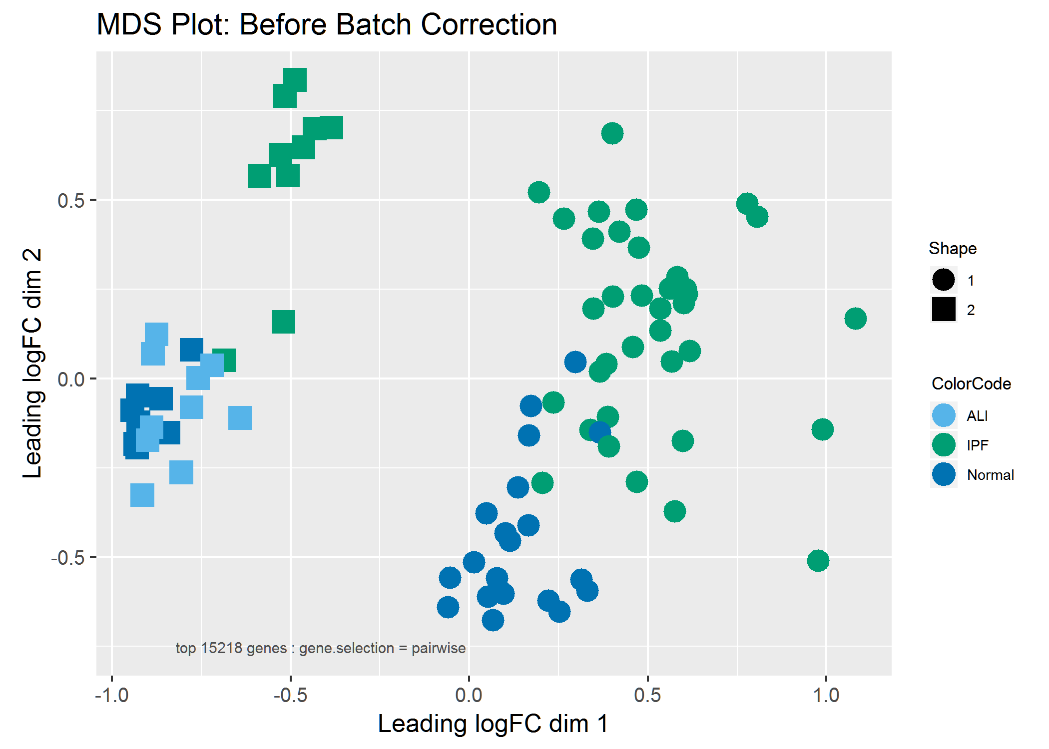
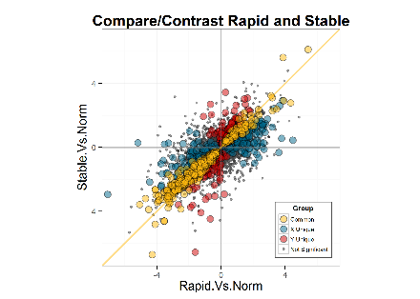
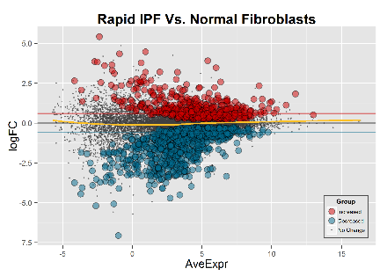
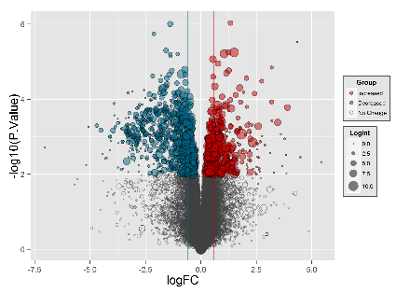
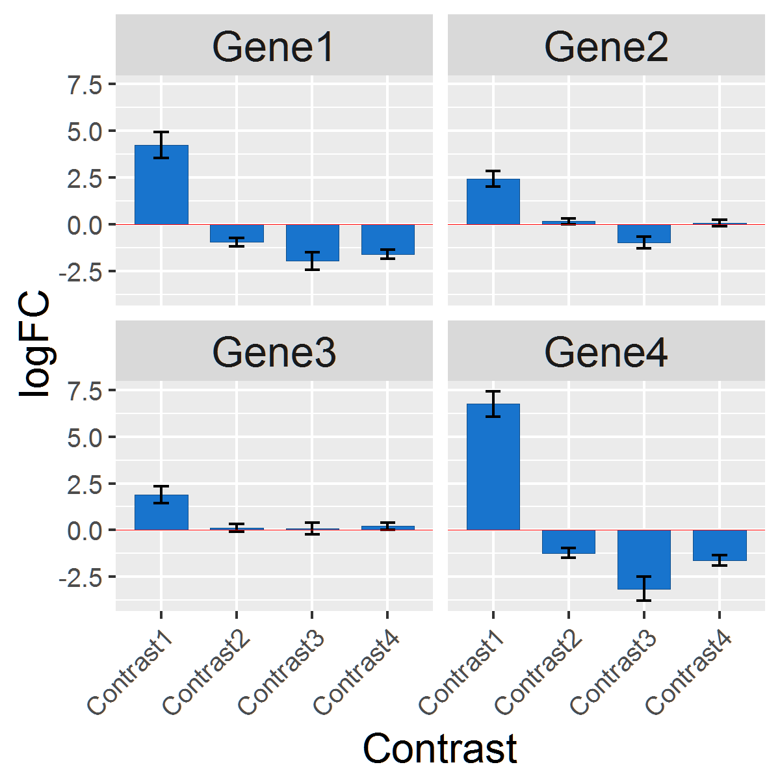
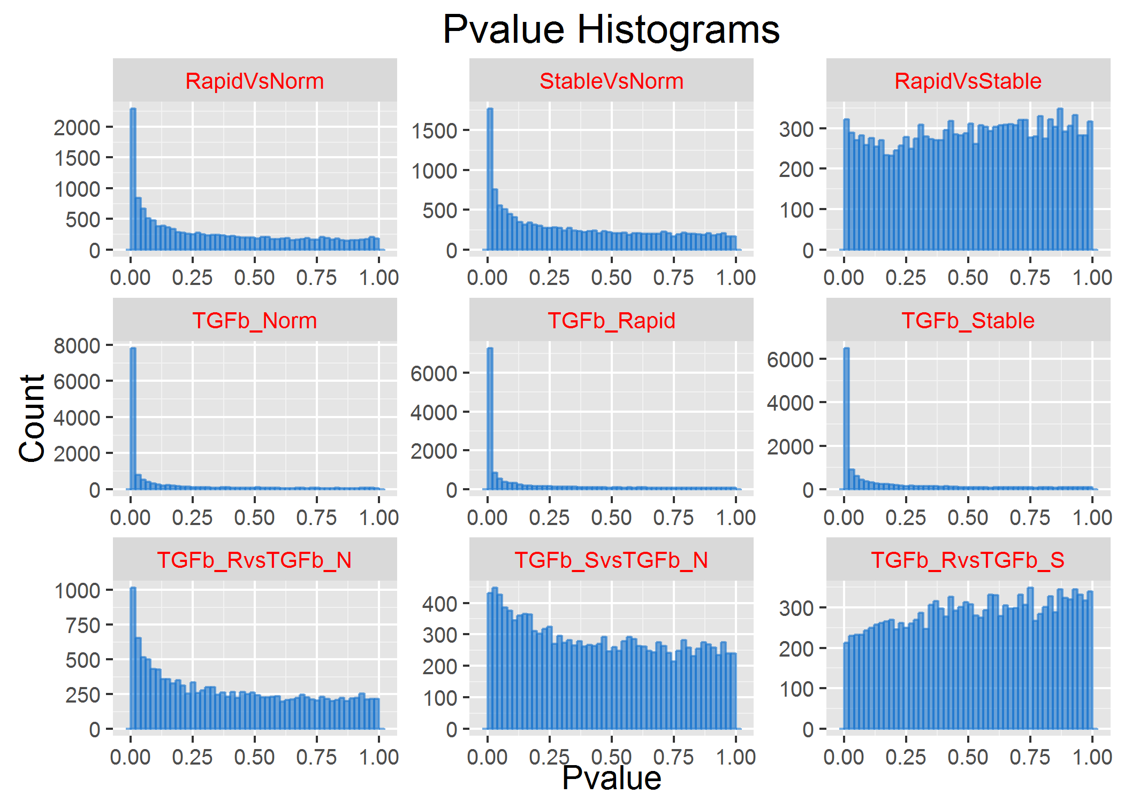
DGE.Tools2 Plotting Functions
runContrasts
DGEobj
MDS Plot
plotDispersion
comparePlot
ggplotMDS
Plot Tools
plotPvalHist
profilePlot
volcanoPlot
profilePlot
volcanoPlot
cdfPlot
obsPlot
comparePlot
GOI Plots
LogRatio GOI
plotPvalHist

